Slide 1
Dasar Sistem Komputer
Pertemuan 1

Slide 2
Isi
What is digital ?
Analog vs Digital
Keuntungan & Kerugian Digital

Slide 3
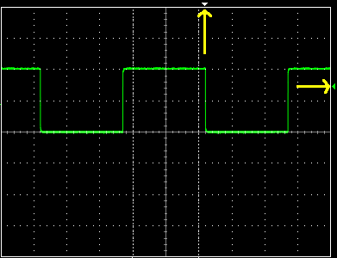
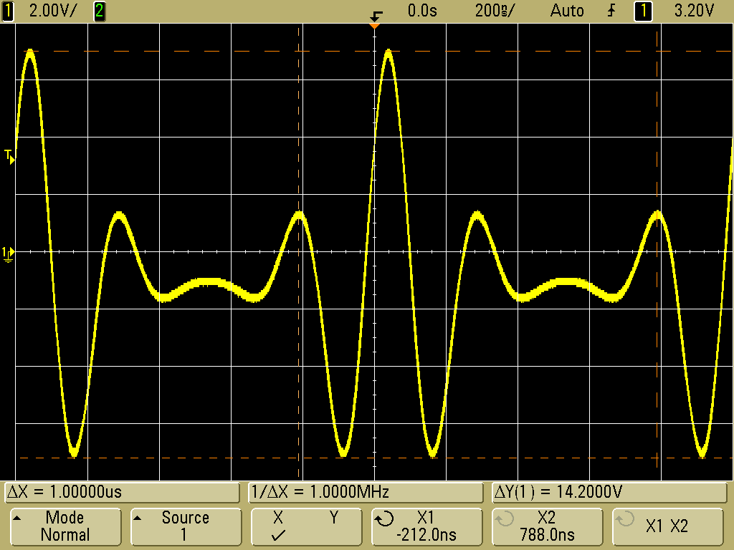
What is Digital (1/2)
A digital signal is a signal that can only have discrete values in time
  Most common are binary digital signals, where only two values are allowed often designated as 0 and 1
The opposite is analog signals that can take infinite values

Slide 4
What is Digital (2/2)
A digital system processes digital signals
Examples: computer, cellphone, DVD, digital camera, etc.

Slide 5
Okay, what is a signal then?
A signal is a physical quantity (sound, light, voltage, current) that carries information
  The power cable supplies power but no information (not a signal)
  A USB cable carries information (files)
Examples of quantities used as digital information signals
  Voltage: 5V (logic 1), 0V (logic 0) in digital circuits
  Magnetic field orientation in magnetic hard disks
  Pits and lands on the CD surface reflect the light from the laser differently, and that difference is encoded as binary data

Slide 6
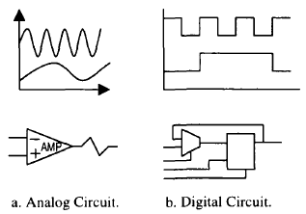
ANALOG VS DIGITAL
Analog devices and systems: Process analog signals (time-varying signals that can take any value across a continuous range known as dynamic range)
Digital devices and systems: Process digital signals (analog signals that are modeled as having at any time one of two discrete values)

Slide 7
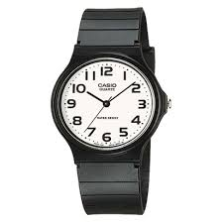
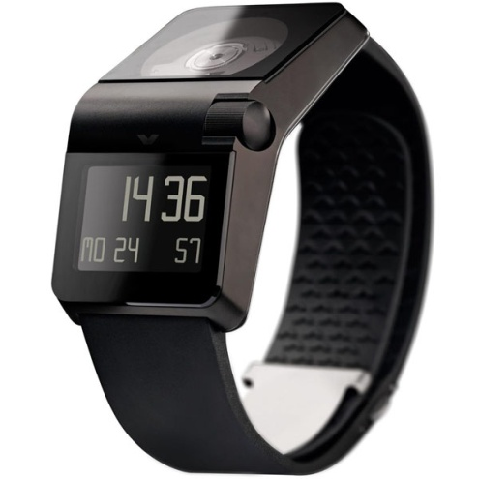
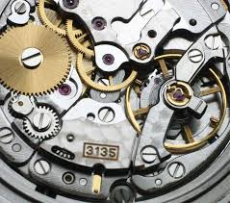

Example of analog vs digital system
Digital advantages:
Battery life
Programmability
Accuracy

Slide 8
The world is analog
Few systems like the watch can be completely digital
Systems that interact with the environment, need to process analog information
How? Analog signals must first be converted to digital

Slide 9


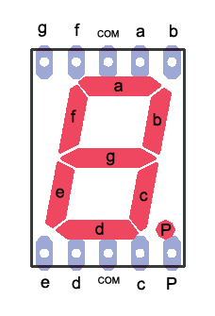


Example of analog vs digital system
Analog
Digital
Temperature sensor (analog)
A/D
converter
Display

Slide 10
ANALOG GOES DIGITAL
Photography
Video
Audio
Automobile applications
Telephony/Telecomunications
Traffic lights
Special effects

Slide 11
WHY DIGITAL?
ADVANTAGES OF DIGITAL PROCESSING
Reproducibility of results
Ease of design
Programmability
Speed
Noise tolerance

Slide 12
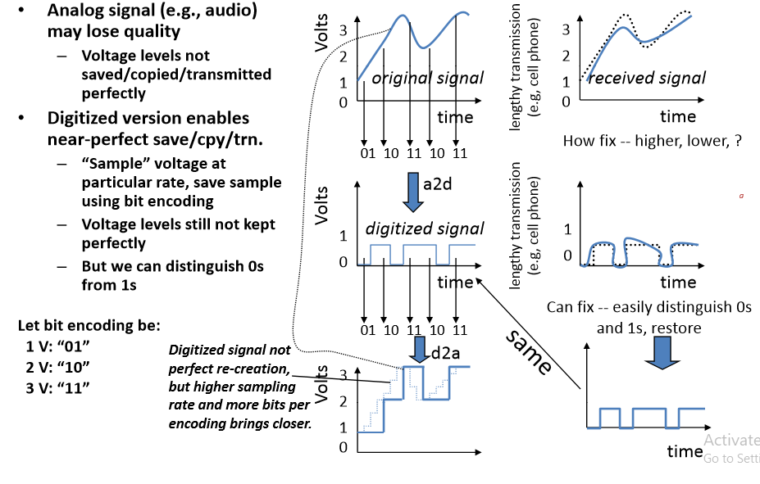
Advantage of Digital

Slide 13
Binary digital signal ‐‐ only two possible values
  Typically represented as 0 and 1 O Bi di it i bit
  One Binary digit is a bit
  We’ll only consider binary digital signals
Binary is popular because
  Transistors, the basic digital electric component, operate using two voltages
  Storing/transmitting one of two values is easier than three or more (e.g., loud beep or quiet beep, reflection or no reflection)

Slide 14
What is design?
  Given problem spec solve it with available components
  While meeting quantitative (size, cost, power) and qualitative (beauty, elegance)
What is logic design?
  Choose digital logic components to perform specified control, data manipulation, or communication function and their interconnection
  Which logic components to choose? Many implementation technologies (fixed‐function components, programmable devices, individual transistors
  on a chip, etc.)
  Design optimized/transformed to meet design constraints

Slide 15
Advance Digital Logic Design
Complicated Circuit (Processor, Memory)
• IC (<100) MSI (100-3000), LSI (3000-10^{5l}), VLSI (10⁵-10⁶), ULSI (>10⁶)
• CAD Tool to accelerate
  Design, Model, Simulate, Validate, Test
  Placing, Routing, Power distribution
• VHDL/Verilog Simulation
• Schematic Editor
• Embedded System

